Slide 1

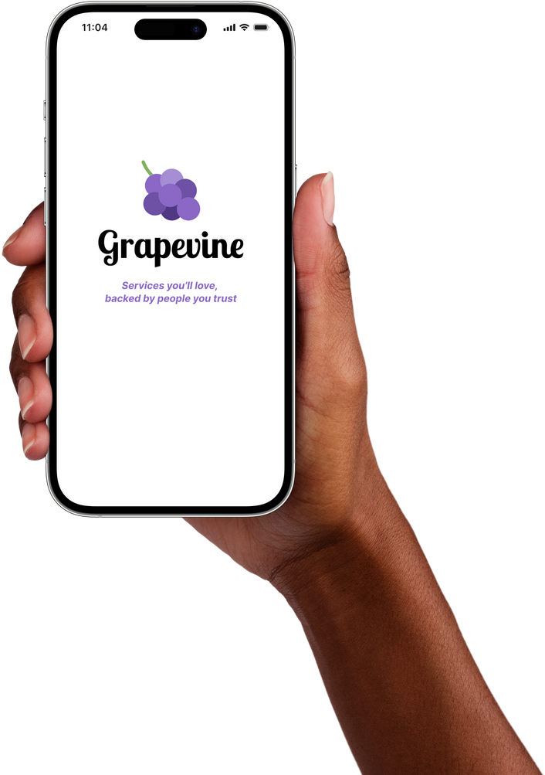
Studio: Unintentional Good
A8:
INTERACTIVE HIGH-FI PROTOTYPE

Slide 2
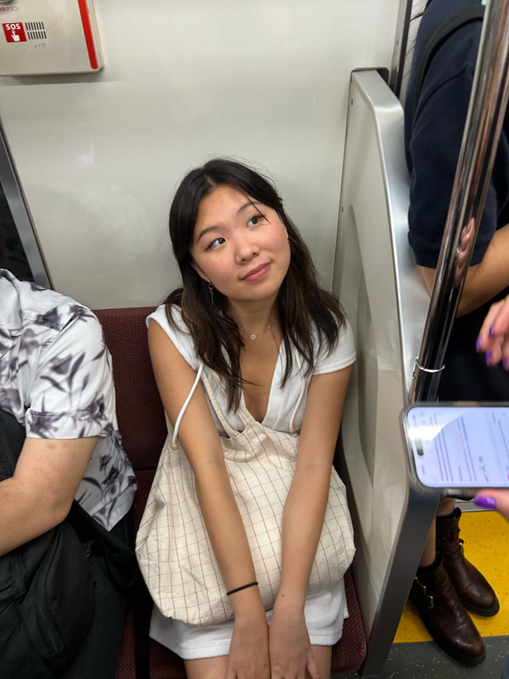
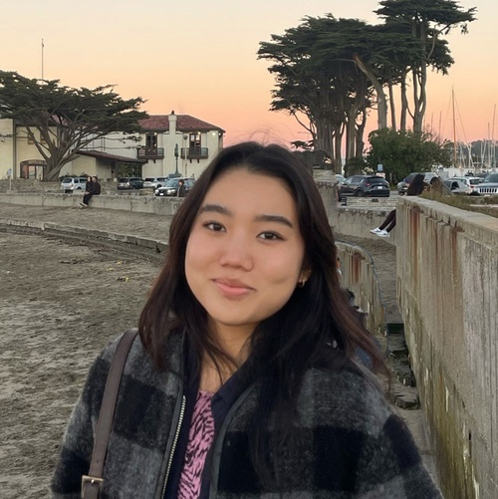

The Team
Emily Deng
Jenna Kim
Ariane Lee
Ariane Lee
Computer Science ‘25
Computer Science ‘25
Symbolic Systems ‘25
Computer Science ‘25

Slide 3
What's Inside
01 | Project Title & Value Prop
02 | Problem/Solution Overview
03 | Heuristic Evaluation Results
04 | UI and Product Revisions
05 | Prototype Implementation Status
06 | Demo
07 | Q&A

Slide 4
01
Grapevine

Slide 5
VALUE PROPOSITION
Services you’ll love backed by people you trust.

Slide 6
Problem
Solution
People struggle to find services that suit their personal needs, as online reviews are often unreliable and impersonal.
Our app facilitates the search for quality services by allowing users to seek and share vetted recommendations through an extended network of friends, encompassing a variety of needs from plumbing to child care.

Slide 7
03
Heuristic Evaluation Results

Slide 8
Category | Sev 0 | Sev 1 | Sev 2 | Sev 3 | Sev 4 | Total Number
H1: Visibility of Status | 0 | 0 | 3 | 2 | 0 | 5
H2: Match Sys & World | 0 | 3 | 2 | 0 | 0 | 5
H3: User Control | 0 | 1 | 0 | 1 | 0 | 2
H4: Consistency & Standards | 0 | 4 | 7 | 4 | 0 | 15
H5: Error Prevention | 0 | 0 | 3 | 0 | 0 | 3
H6: Recognition not Recall | 0 | 0 | 3 | 1 | 0 | 4
H7: Efficiency of Use | 0 | 1 | 0 | 2 | 0 | 3
H8: Minimalist Design | 1 | 4 | 2 | 0 | 0 | 7
H9: Help Users with Errors | 0 | 0 | 2 | 2 | 0 | 4
H10: Help & Documentation | 0 | 0 | 3 | 0 | 0 | 3
H11: Accessible | 0 | 0 | 1 | 1 | 0 | 2
H12: Value Alignment & Inclusion | 0 | 0 | 3 | 2 | 0 | 5
Total Violations by Severity | 1 | 13 | 26 | 18 | 0 | 58

Slide 9
High-Level Summary
H4: Consistency and Standards
26%
H8: Minimalist Design
12%
H1: Visibility of System Status
9%
H12: Value Alignment and Inclusion
9%
Severity 4
0/58
Severity 3
18/58
Severity 2
26/58

Slide 10

High-Level Summary
H4 Consistency & Standards
Wording and phrasing across screens
Confusion regarding recommend vs. endorse
H8 Minimalist Design
Grid alignment, colors, clutter
Utility of the home page: social app or functional app?
H1 Visibility and System Status
More prompts to guide the user towards action items
Information or documentation to keep user informed
H12 Value Alignment and Inclusion
Too many features and screens --> decrease in efficiency
Additional
Limited abilities to undo, delete, or edit actions
Rethinking visibility/privacy details
Consolidating search/create recommendation

Slide 11
Additional Details
On Severity 2-3 Violations
Fix confusion regarding recommend vs. endorse
“..difficult to tell which friend originally recommended which service, and which other friend endorsed” Violation #5 (H1 Severity 3)
“.. it does not make sense to me what the star button is” Violation #10 (H2 Severity 2)
“..[the star button] leading to different actions at different times is confusing for users” Violation #23 (H4 Severity 3)
“.. Users may be confused by this inconsistent iconography for the same function of leaving a recommendation.” Violation #27 (H4 Severity 2)
“.. friends in a user’s network can either “endorse” or “also recommend” another service, but no clear distinction is made between the two different actions” Violation #24 (H4 Severity 3)

Slide 12
Additional Details
On Severity 2-3 Violations
More prompts, explanation, and documentation to guide and inform users
“After clicking the search icon in the bottom navigation bar...no other prompt relating to what to search for.“ Violation #2 (H1 Severity 2)
“[While trying to create a recommendation,] the search bar does not tell you what you are searching for...”
Violation #31 (H6 Severity 2)
“...no notification that is sent to the user if someone accepts their request in the inbox...Users would likely want to see if a request has been fulfilled so they can act on the recommendation.” Violation #3 (H1 Severity 3)
“ Can’t differentiate between this search bar and the simple task search bar... the search bar does not tell you what you are searching for (a business to create a recommendation).”
Violation #28 (H5 Severity 2)
“no documentation of the type of visibility that you set in your pending requests“ Violation #4 (H1 Severity 3)

Slide 13
Additional Details
More user control to prevent and recover from errors (e.g. editing features)
“post privacy settings [are] above of photo attachment button...it would be difficult to know that there is an option to attach a photo until it’s already too late, and users could get frustrated.
” Violation #50 (H11 Severity 3)
“In the event that a user categorizes the wrong type of recommendation, a nanny as a plumber, it might be helpful to add an additional check or method to ensure that this sort of error does not occur...Violation #44 (H9 Severity 3)
“The user is able to post a recommendation request to their network even if they have not filled out any and/or all of the fields.“ Violation #45 (H9 Severity 3)
“There is no way to change the type of visibility after request is sent” Violation #46 (H9 Severity 3)
“There is no way to edit a posted recommendation” Violation #11 (H3 Severity 3)

Slide 14
04
UI and Product Revisions

Slide 15
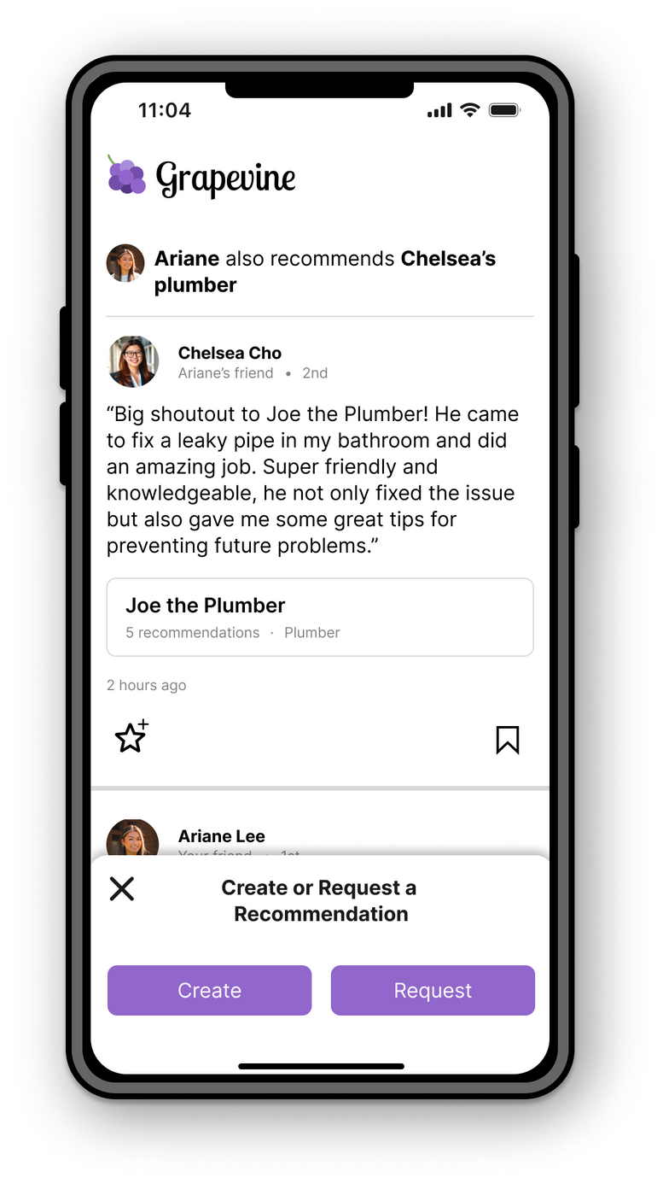


Issue 1
Users were confused about the difference between endorsing and recommending.
Relating to violations 5, 10, 23, 34, 37...

Slide 16
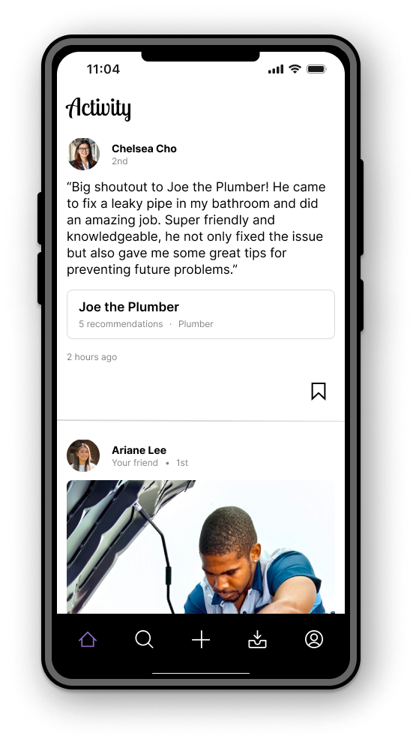
Revision 1
We decided to delete the ‘endorse’ feature altogether, as it did not provide significant enhancements to our app’s functionality and only confused users.
This change supports our usability goal of robustness by reducing confusion. It also resolves other issues regarding inconsistencies with our language surrounding endorse vs. recommend.

Slide 17
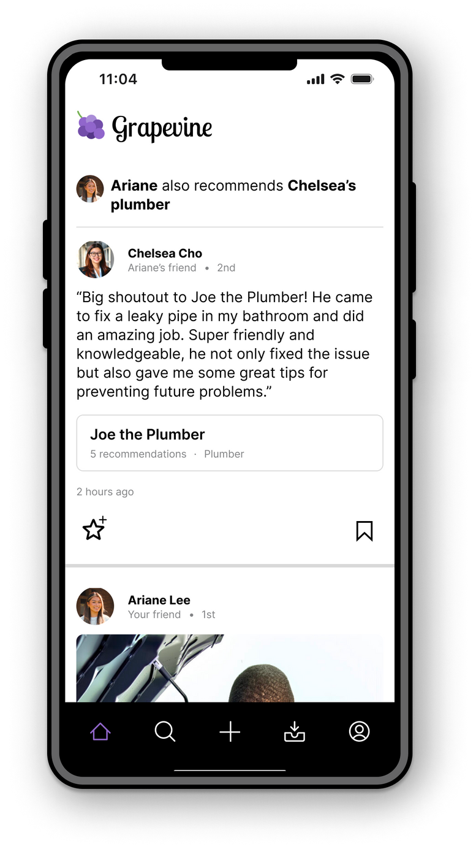
Issue 2
Users felt that the home/feed page didn’t serve much purpose; it was suggesting Grapevine is a social app when really it should be a functional one.
Relating to violation 41, 55

Slide 18
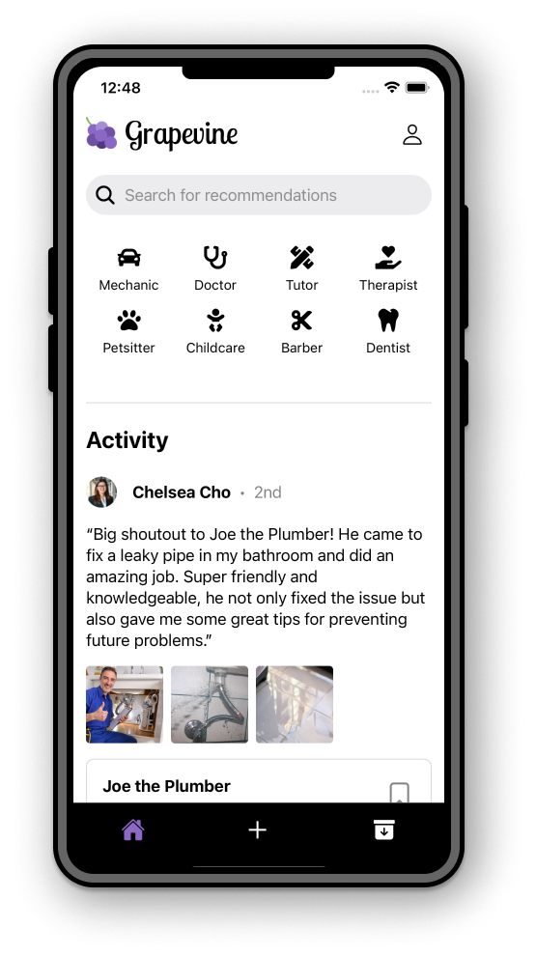


Revision 2
We decided to make the home page the search page instead, as users are most often going to search for recommendations. However, we retained the feed as part of the backdrop (similar to Yelp or Doordash), as it may be important to some users to see their friends’ activity.
This change supports our usability goal of efficiency by reducing the number of steps it takes to find a recommendation. It also reduces number of tabs overall.

Slide 19
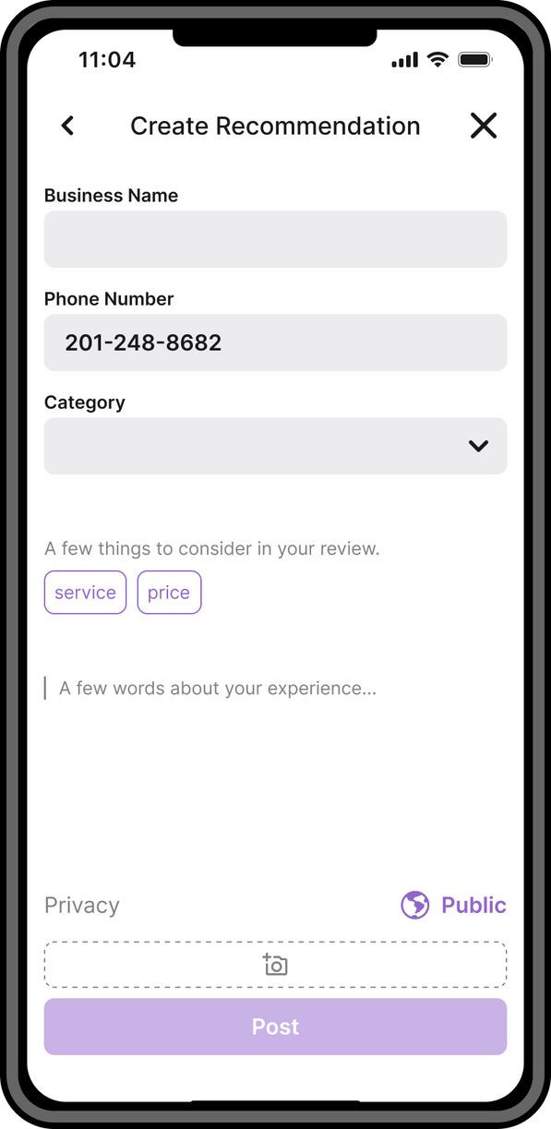

Issue 3
When making a post, privacy settings are located above the photo attachments, but they should be the last thing users set before they make the post. Otherwise, users may not know there is an option to attach a photo if they believe they are done.
Relating to violation 50

Slide 20
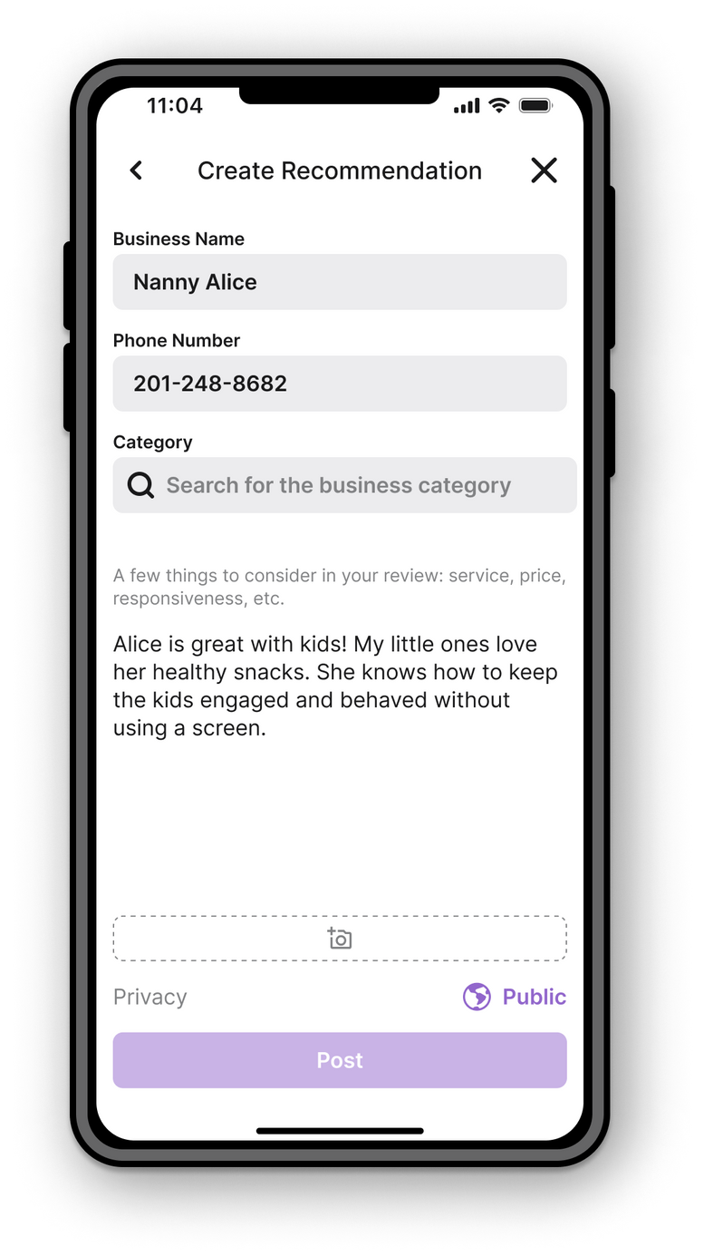
Revision 3
We moved the privacy settings below the photo attachments.
This change helps achieve our robustness goal, as users are less likely to make the mistake of not attaching a photo that they wanted to include.

Slide 21
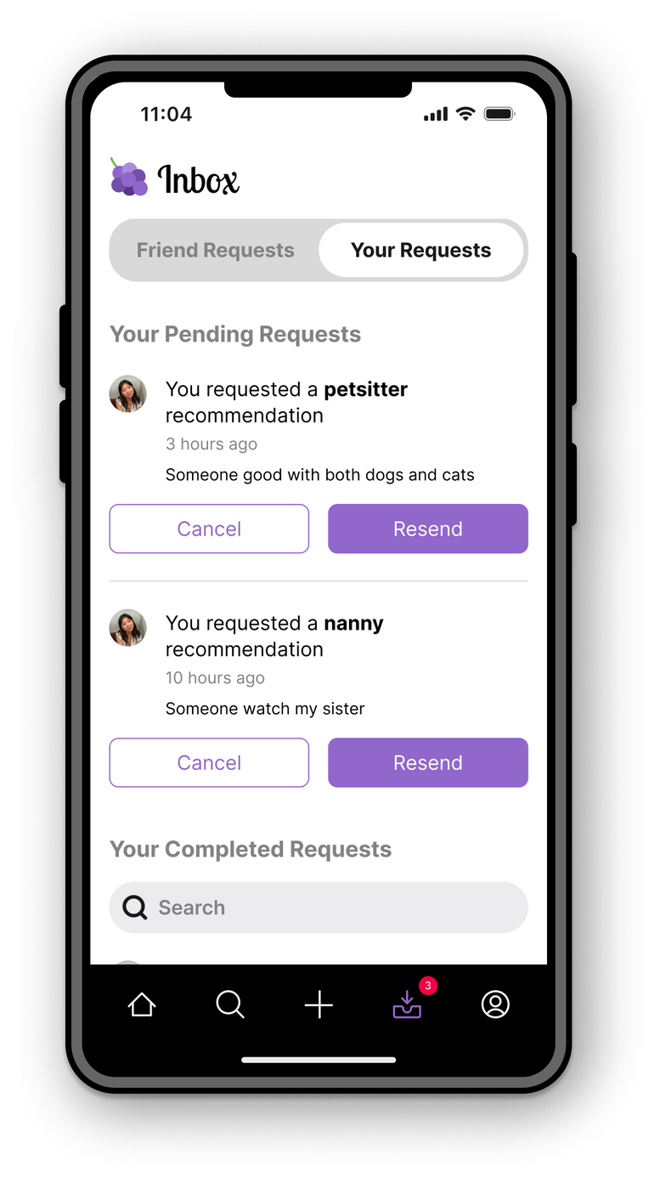
Issue 4
There is no documentation of or option to change the type of visibility that a user sets for their pending requests. The same goes for posted recommendations.
Relating to violations 4, 11, 46, 22

Slide 22
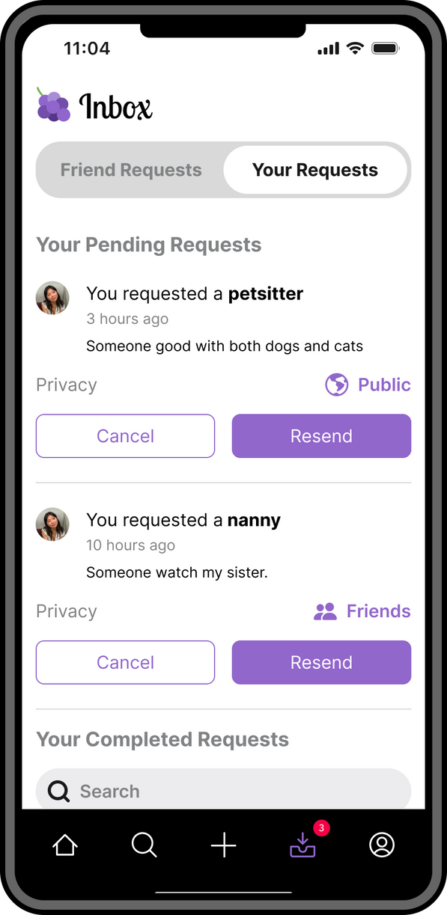

Revision 4
We added a clickable icon that corresponds with the level of visibility a user initially selected, also allowing for future modification should the user change their mind.
This change helps us achieve our efficiency goal, as users can more easily make changes.

Slide 23
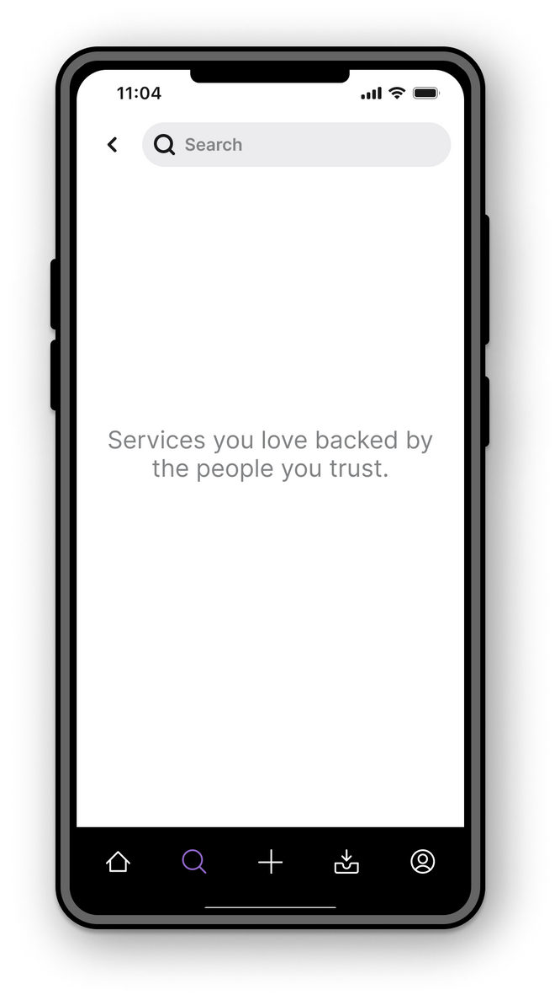
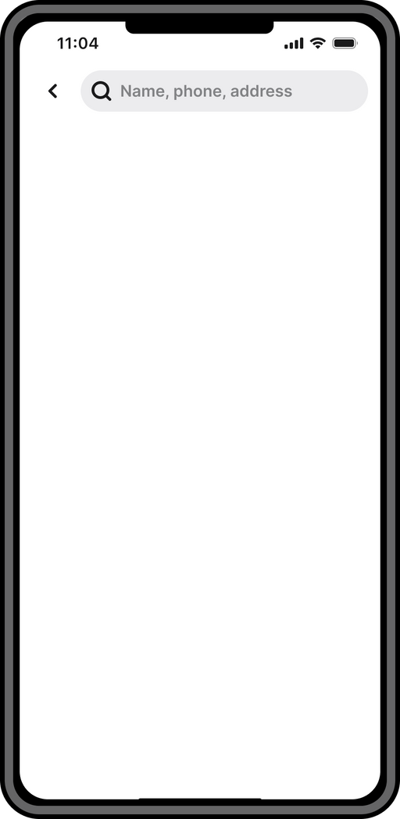
Issue 5
The search page does not prompt user on what to search for, which can be additionally confusing when have two search pages (find recommendation vs. create recommendation).
Relating to violations 2, 28, 31

Slide 24
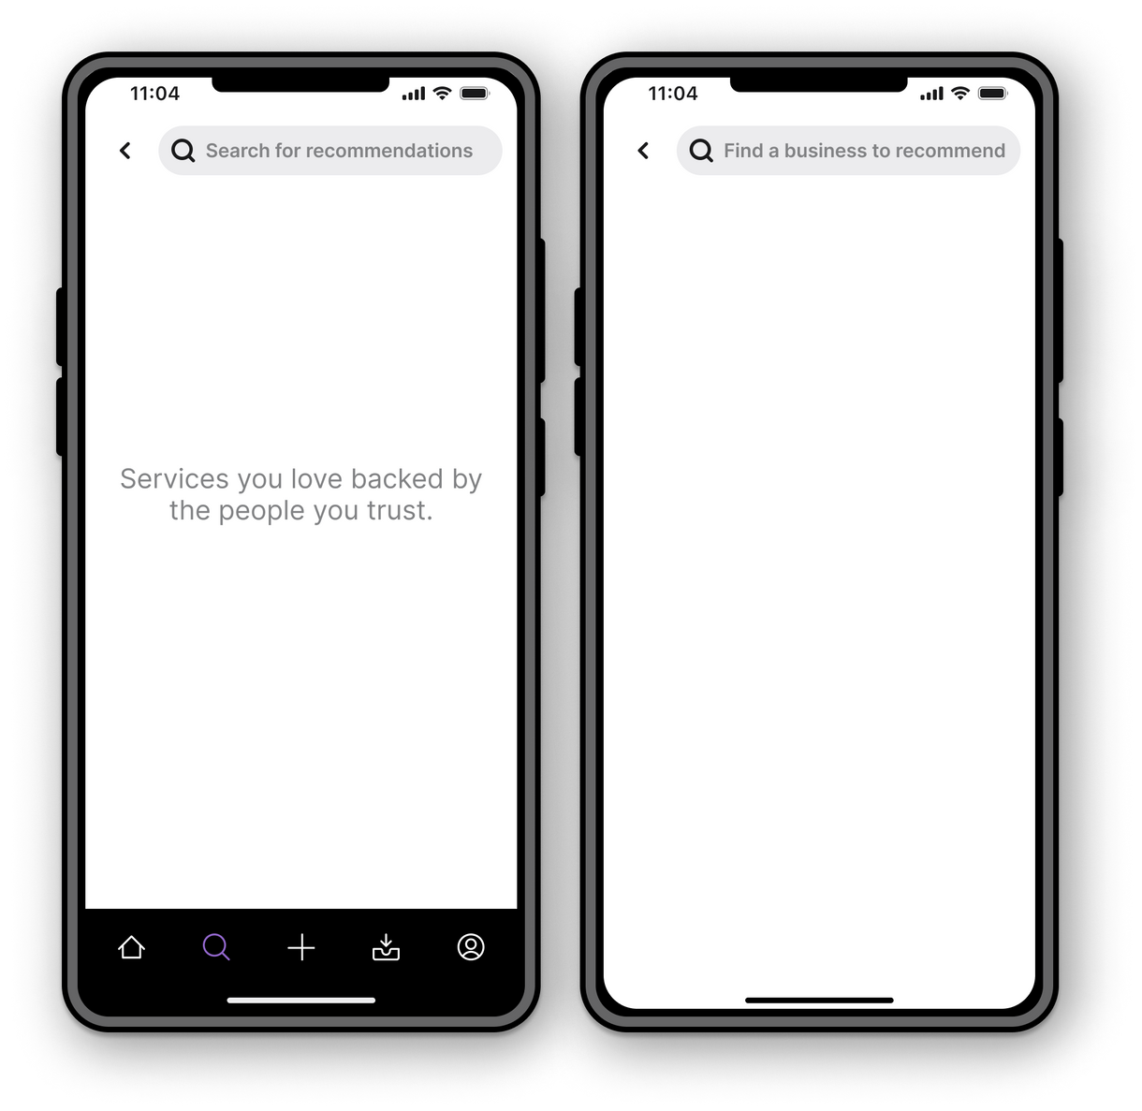
Revision 5
We added a prompt within the search bars themselves. We also combined the feed and simple task search within the home screen to better differentiate two searches.
This change achieves our usability goal of robustness, as users are guided towards what they should search for.

Slide 25
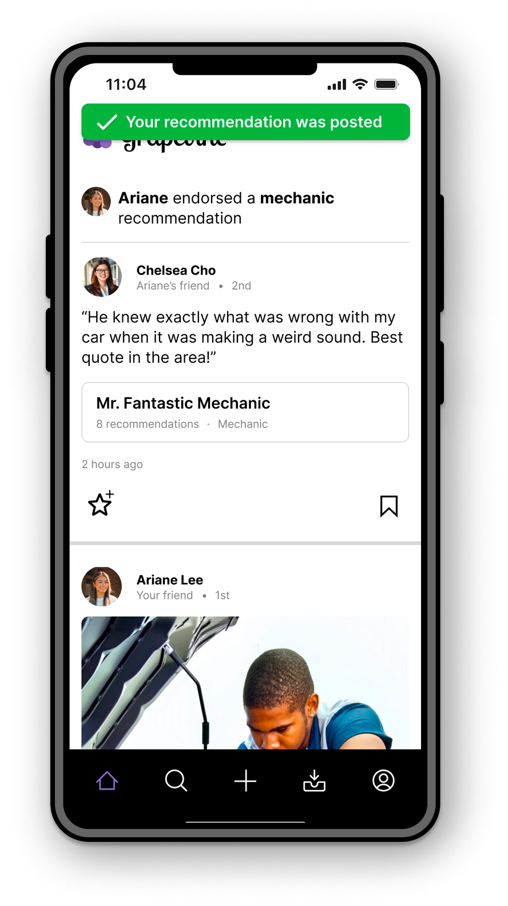
Issue 6
There is no way to edit posted recommendations.
Relating to violation 11

Slide 26
Revision 6
This feature will be available in the profile page (not pictured).
This change works towards our goal of robustness, as users can modify their written reviews or visibility settings if they realized a mistake later on.

Slide 27
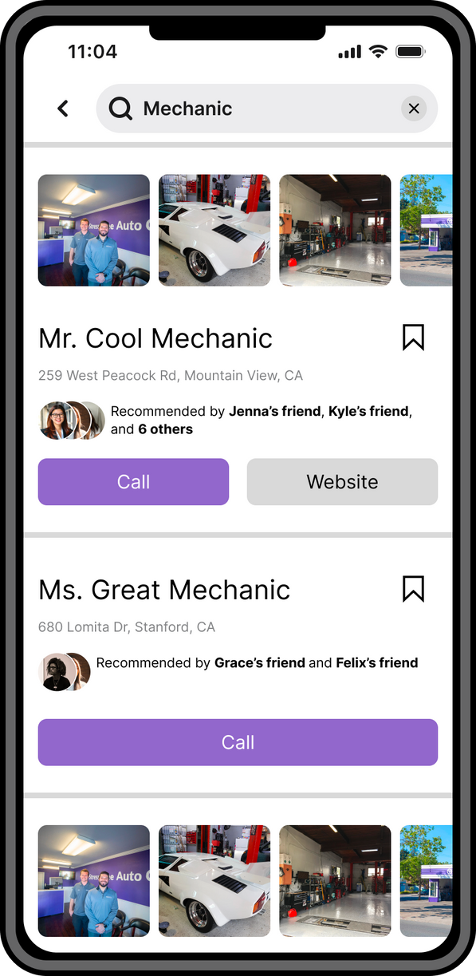
Issue 7
Some of the search results have both “call” and “website” options whereas others only have “call.” This inconsistency drew significant attention to the singular “call” button, as it was large and purple.
Relating to violation 14

Slide 28
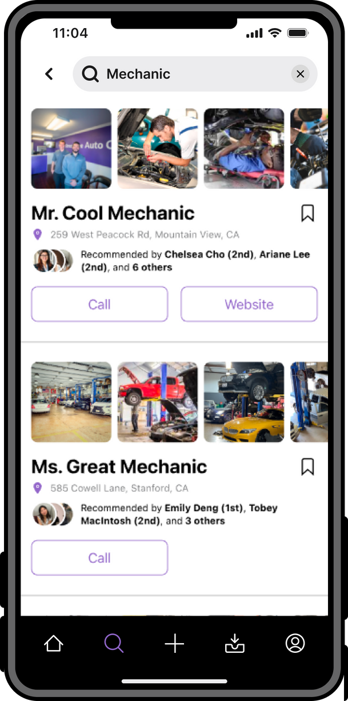
Revision 7
We took inspiration from Google maps and decided to keep all buttons the same color, even when other buttons aren’t present.
This change works towards our robustness goal, as users are less confused when there is consistency.

Slide 29
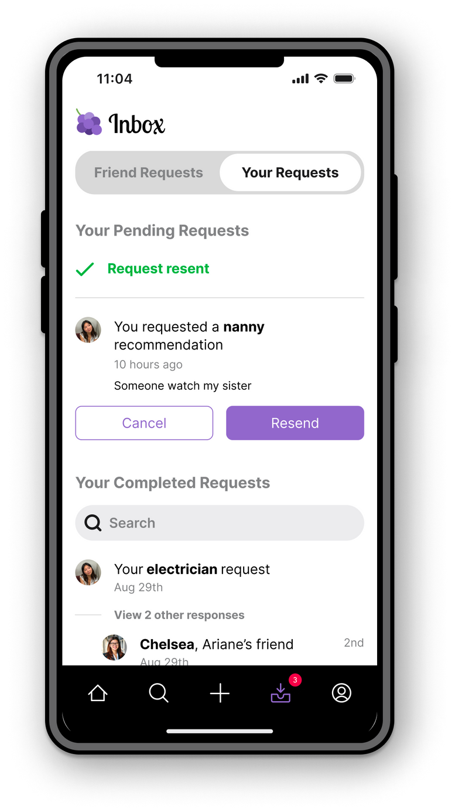
Issue 8
Users are not informed when a request they send out has been completed, the request just moves from “pending” to “completed.”
Relating to violation 3

Slide 30
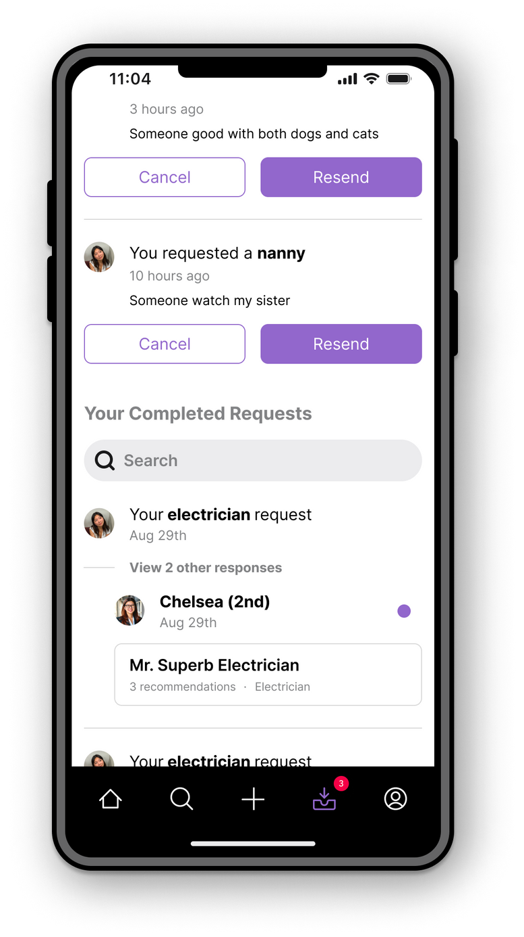
Revision 8
Users receive a notification when when their request has been completed as a badge, and any unread completed requests will have an unread indicator dot.
This change helps achieve our efficiency goal, as users can more quickly find the services they need.

Slide 31
Issue 9
Within the search results page, it is difficult to differentiate between the start/end of each result, especially for the visually impaired. This was more confusing when certain results didn’t have pictures.
Relating to violation 26

Slide 32
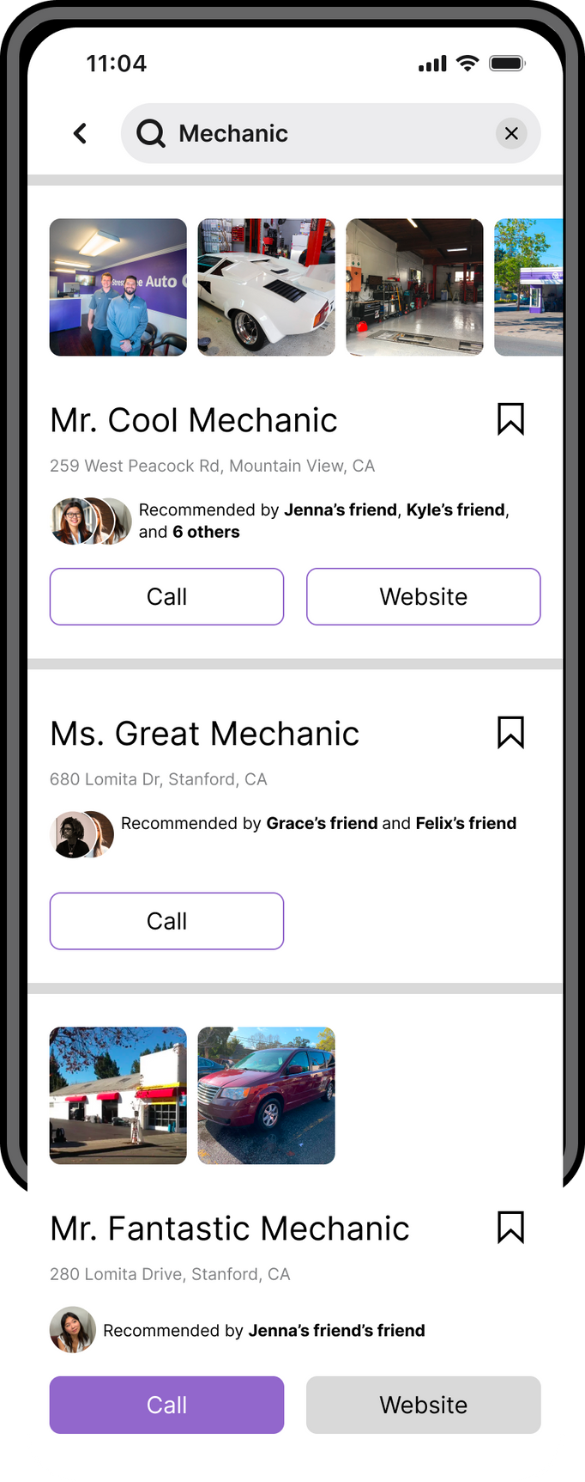
Revision 9
We standardized the format of search results, even when there are no photos. We also increased the gutter between results.
This change supports our robustness goal, as users will be less confused about the distinct search results, clicking only where they intend to.

Slide 33
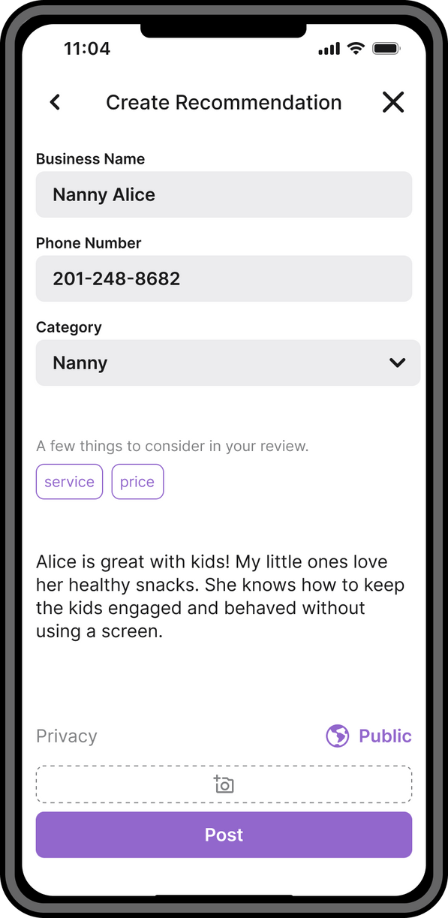
Issue 10
Within the create a recommendation page, users can select a service type from a dropdown menu, but this may lead to accidental mis-categorization. It may also omit certain service types.
Relating to violation 44

Slide 34
Revision 10
Instead of a dropdown menu, we implemented a search bar where users can start typing their service type and select from the results (or just type the entire entry should a result not match).
This change helps achieve our usability goal of robustness, as users are less likely to mis-categorize a service without noticing.

Slide 35
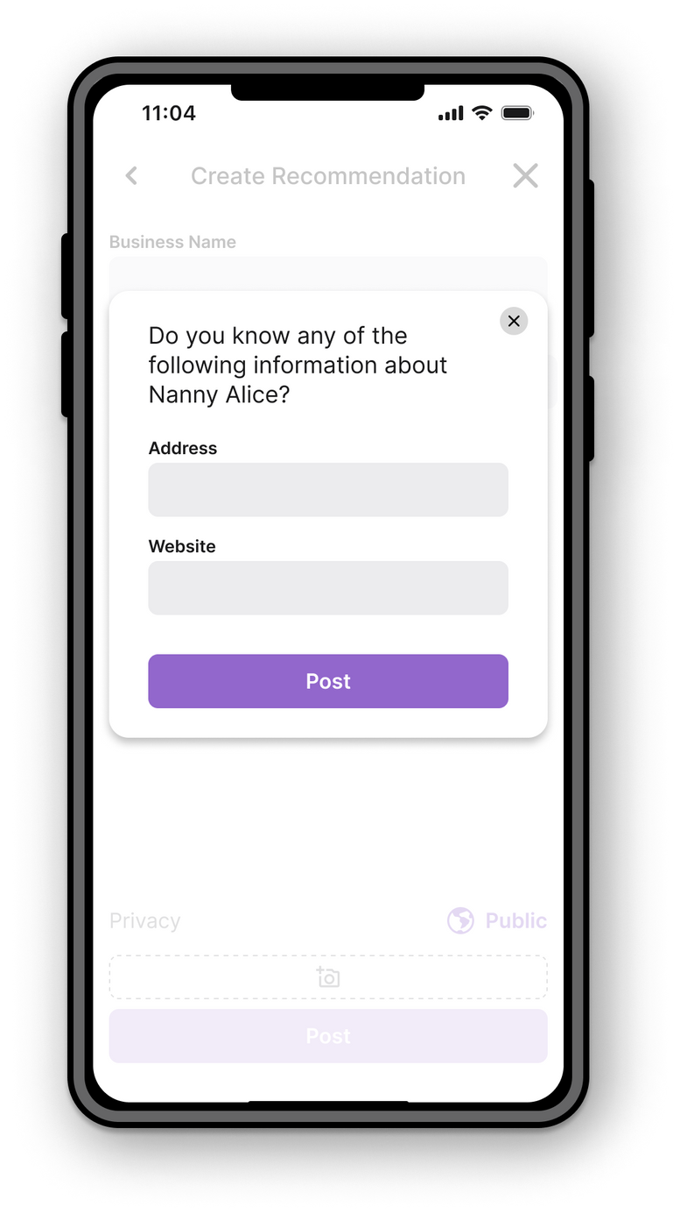
Issue 11
Users are able to post a recommendation request even if they have not filled out any/all the fields.
Relating to violation 45

Slide 36
Revision 11
We made the “Post” button greyed out and until all required fields are filled out. Should the user click it prematurely, they will be prompted to correct their error via box highlights and messages.
This change helps achieve our robustness goal, as it guides the user to properly requesting a service recommendation.

Slide 37
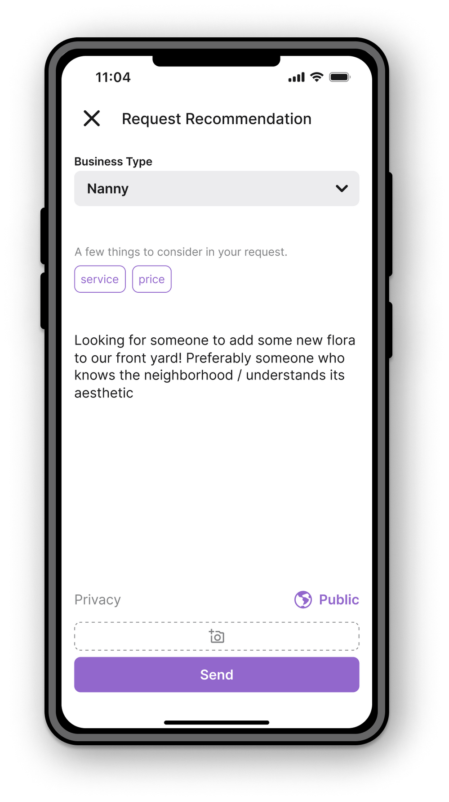
Issue 12
The create and request a recommendation pages prompt users to consider a couple of factors in their posting (such as service and price) rather than letting the user choose specific inputs that suit their personal needs.
Relating to violation 17

Slide 38
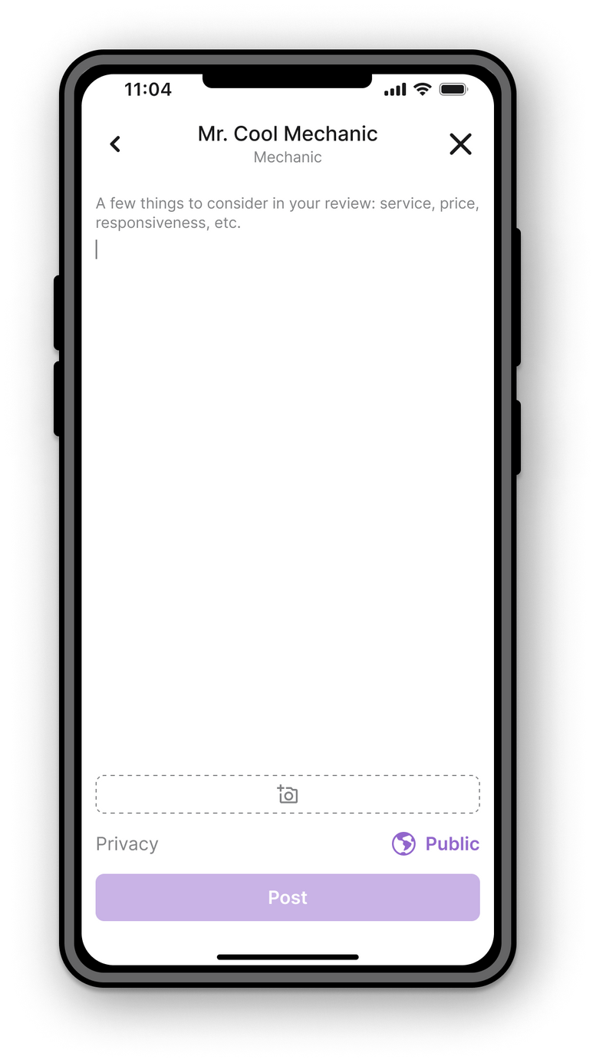
Revision 12
Instead of expressing these factors as tags, we will write them into the prompt itself. Then, users will know that they are not clickable or functionally meaningful tags, just suggestions.
This change helps achieve our robustness goal by reducing confusion and, subsequently, error rates.

Slide 39
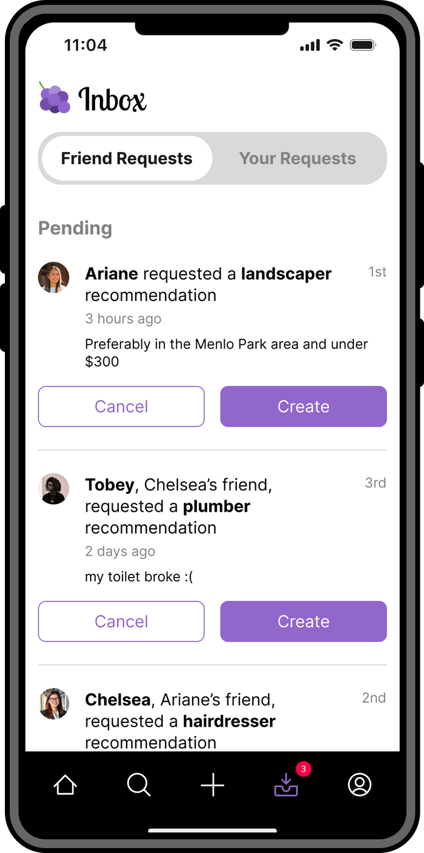
Issue 13
Specifying people’s connections with each other becomes confusing and verbose, especially when two people can have multiple mutuals (e.g. “Tobey, Chelsea’s friend’s Ari’s friend,” or even “Tobey, Chelsea and Riley’s friend’s friend).
Relating to violation 33, 34

Slide 40
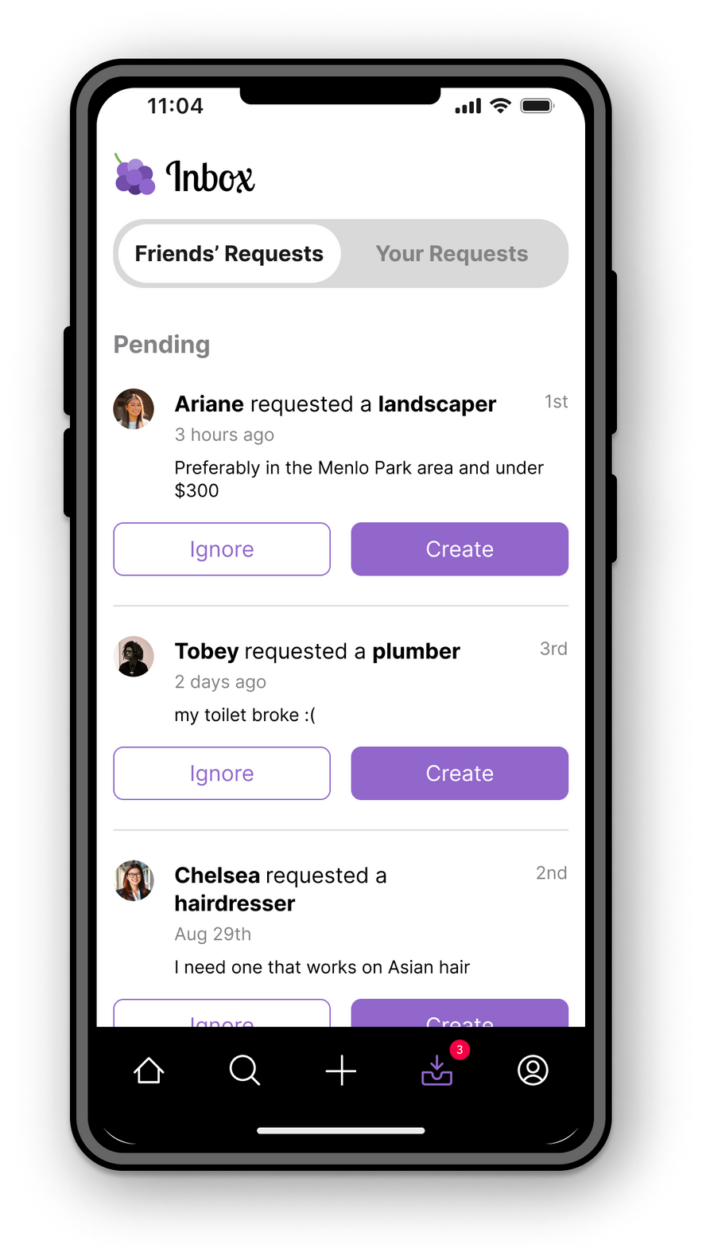
Revision 13
To reduce the wording, all individuals are referred to by their name. Further information about their degree of connection is available on the side (see revision 10).
This change supports our usability goal of efficiency, as it will increase readability.

Slide 41
Issue 14
When searching for a mechanic within your network, there is a back button as well as an “x” button in the search bar, which both cancel the current search.
Relating to violation 12

Slide 42

Revision 14
Since we have consolidated the search bar to the home/feed page, there is no longer a need for a back button.
This change works towards our robustness goal, as eliminating redundancies makes usage easier for users.

Slide 43
Additional Severity 3 Violations
#32 H6:
“[Lack of] Action items for finding no results when searching for a recommendation...there should immediately be an option to request a recommendation...”
# 35 H7:
“Search/create recommendation requests being two separate entities and abilities...removes the advantage of having an app like Grapevine. The burden is all still completely on the user to figure out where to go for a certain service.”
# 52 H12
“When browsing through their feed of recommendations, users are not able to view any information about the actual service / business except for their friend’s recommendation blurb and if they chose to post a picture.
We intended to have this feature, but it was not feasible in Figma because we did not have a fully fleshed out ‘search.’ It will be present in Hi-Fi.
We did not want to add more information in the feed posts, as this may clutter the screen. Users can easily navigate towards more information by clicking on the business name.
We thought that combining search/create recommendation might be confusing, especially when other apps already have similar functionalities separate. Professor Landay agreed with us.

Slide 44
05
High-Fi Status

Slide 45







Tools Used
Figma
Ionicons
GitHub
React Native
VSCode
Expo Router
Supabase

Slide 46

Implemented Features
Task 1: Find a service recommendation
Log in
Scroll through feed to see friend activity
Search for a service (via Supabase)
Scroll through search results (services that have been recommended)
Click on results that interest you
Look at a business profile page for further information
Find name, number, website, location, etc.
Horizontally scroll through friends’ recommendations regarding the service

Slide 47

Unimplemented Features
Task 2: Creating a recommendation
Searching for a business to create a recommendation for
‘Create a recommendation’: adding phone, service category, pictures, description
Posting the recommendation at different visibility settings
Task 3: Requesting a recommendation
‘Request a recommendation’: specifying info like service category and personal needs
Sending request out at different visibility levels
Inbox tab with requests you’ve received and requests you’ve sent out to network
Being able to ignore or answer requests from network
Being able to cancel or resend your own requests

Slide 48
Unimplemented Features
Not Specific to Any Task
Native notifications
Error messages
Edit your own posts from the feed
Being able to search for service recommendations by a friend’s name as opposed to a service type (if you really respect one of your friend’s opinions, for example)
Being able to save a service
Data persistence for task screens

Slide 49





Our POA (Plan of Action)
Weekend
Mon/Tue
Wed/Thurs
Friday
Create a recommendation
Request a recommendation
Visibility settings and functionality
Ignore/Answer requests from friends
Cancel/Resend own requests
Data persistence across screens
Notifications
Saving services (TBD)
More advanced search (TBD)
Aesthetics
Practice presentation
Give presentation/slay the day

Slide 50

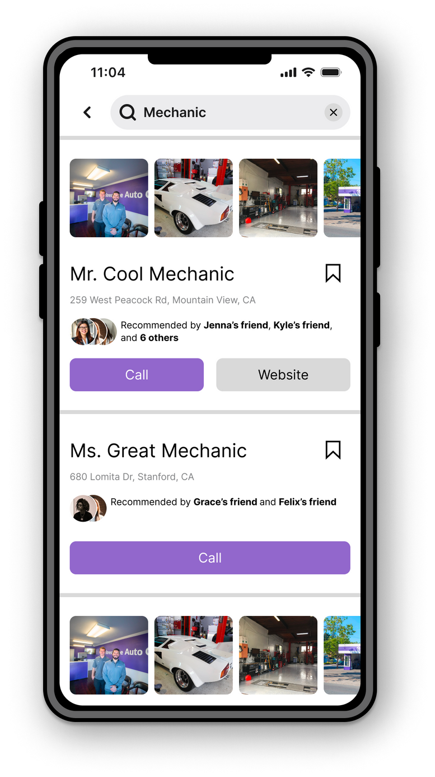
Wizard of Oz Techniques
In this prototype, the user has a built-in network of 1st, 2nd, and 3rd degree friends who have already created recommendations. This choice allows us to demonstrate the full functionality of our app.

Slide 51

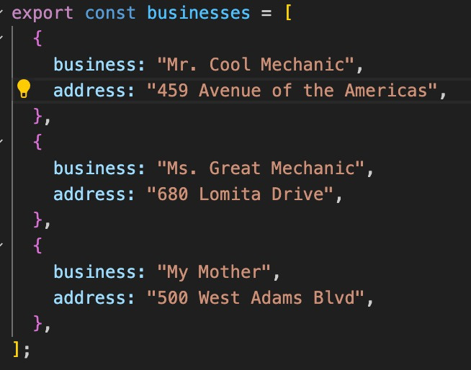
Hard-Coded Aspects
Business profile pages
Name, website, images, location on map
Recommendations from network
Requests you’ve received and requests you’ve sent out (within inbox tab)

Slide 52
Issues/Questions
Does anything outside of the explicit task have to work?
Call a business?
See saved businesses?
How do I use Supabase????

Slide 53
05
Demo!

Slide 54
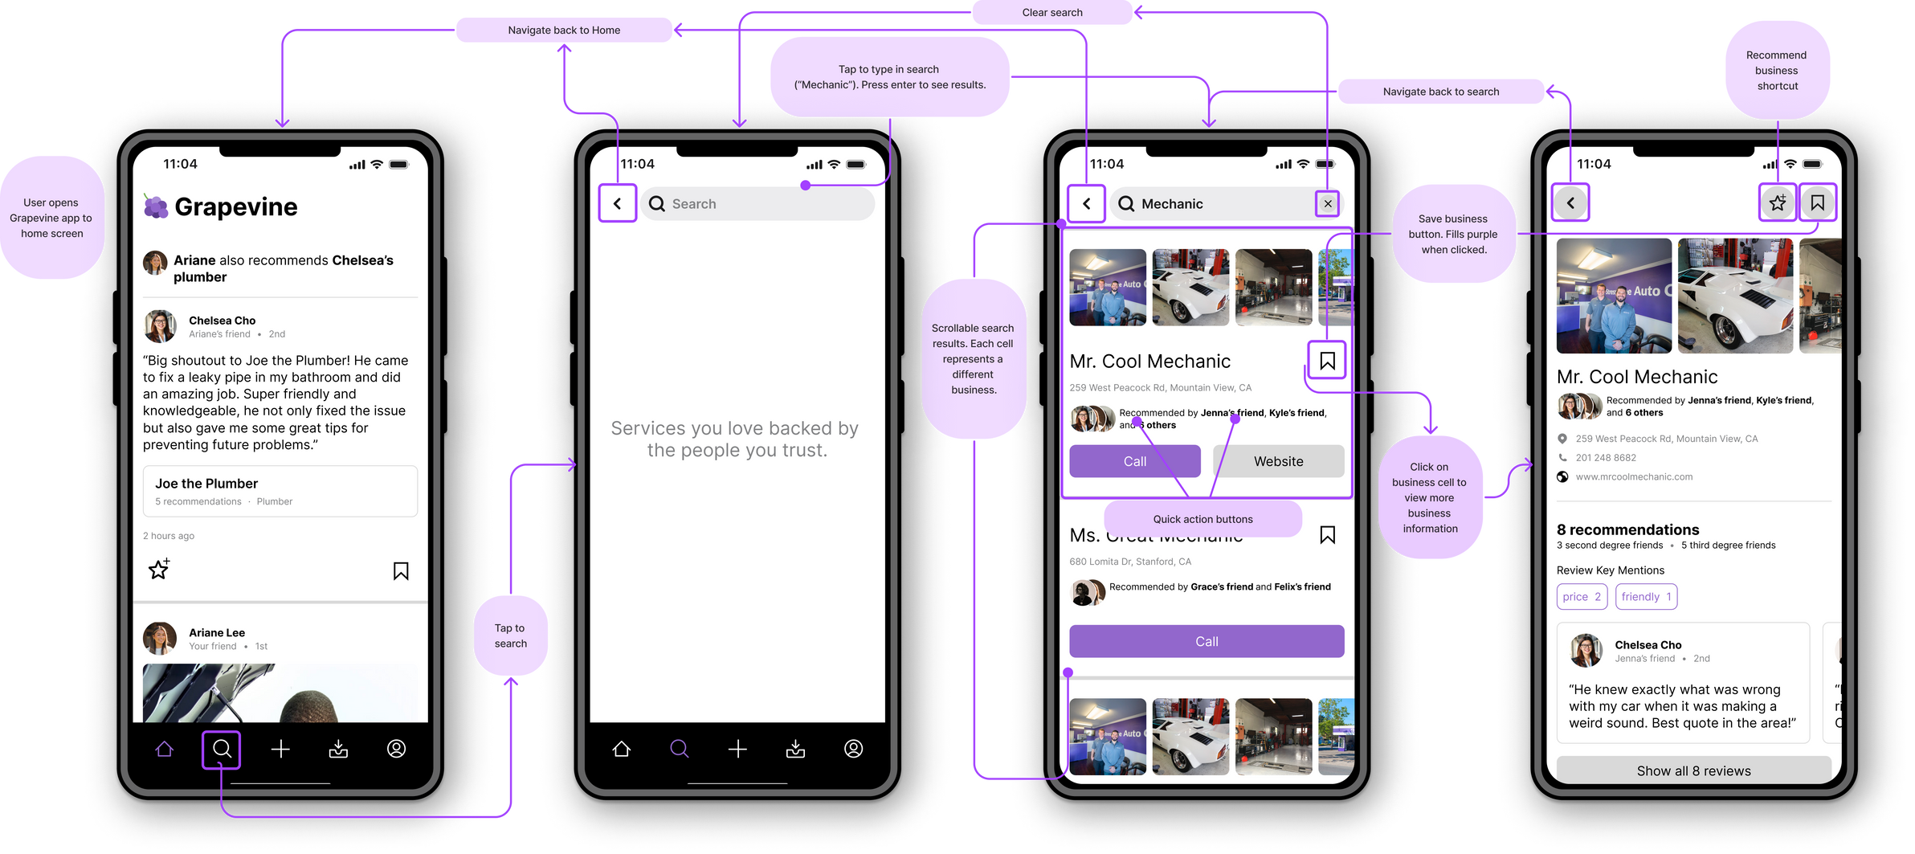
Interactive Figma Prototype
SIMPLE TASK
Searching for a recommendation

Slide 55
07
Questions?

